Slide 1
Independent report of the G20 TF CLIMA Group of Experts
A GREEN AND JUST PLANET:
The 1.5°C Agenda for Governing Global Industrial and Financial Policies in the G20
Prof. Mariana Mazzucato and Dr. Vera Songwe
Co-Chairs
November 25, 2024

Slide 2
Key Messages
OUR OBJECTIVE:
OUR AMBITION:
Global emissions must drop from 57.4 Gt of CO2 equivalent (GtCO2e) in 2022 to 27 GtCO2e by 2030, to achieve the 1.5°C goal of the Paris Agreement.
G20 countries are responsible for 80% of emissions and should take responsibility for 80% of the required reduction.
ACTION:
G20 countries should commit to new development pathways compatible with the Paris Agreement goal of limiting warming to 1.5°C above pre-industrial levels.
Achieving this goal requires green industrial strategy
It also requires a rapid expansion of affordable green finance
Global governance of both green industrial strategy and green finance should prioritise equity
2

Slide 3
Picking up the pace of change
The costs of inaction are far greater than the costs of action
Under current policies, warming is projected to exceed 3°C which would lead to macroeconomic losses of at least 18% of GDP by 2050 and 20% by 2100.
G20 states should act with urgency to reduce emissions and shift investments away from carbon-intensive activities.
G20 emissions continue to rise and fossil fuel subsidies have more than doubled since 2022.
Sources: Swiss Re 2021, NGFS 2022; UNEP 2022; IISD 2023; Ambrose, 2024
3

Slide 4
Market fixing Market shaping
Finance gaps Restructuring finance
4

Slide 5
Dispelling Myths
Common myths blocking urgent action | Counter argument
Myth 1: “Market signals can drive decarbonisation without direct government intervention.” | Markets alone cannot coordinate the rapid and large-scale economic transformation that is needed.
Myth 2: “Climate action will slow economic growth.” | Climate action and economic growth are not mutually exclusive.
Myth 3: “Industrial strategy does more harm than good due to government failure and capture.” | A greater risk of government failure arises from underfunded states that lack adequate capacity to implement industrial strategies that direct growth and shape markets, and that are therefore more prone to state capture.
Myth 4: “Governments don’t have the resources to address climate needs.” | The problem is not a lack of funding but a lack of willingness to direct it towards climate action.
Myth 5: “Blended finance—using public funds to ‘de-risk’ private investments—is always cheaper than public investment.” | Blended finance can lead to higher long-term costs compared to public financing, particularly for middle and low-income countries.
5

Slide 6
2. Delivering green industrial strategy

Slide 7
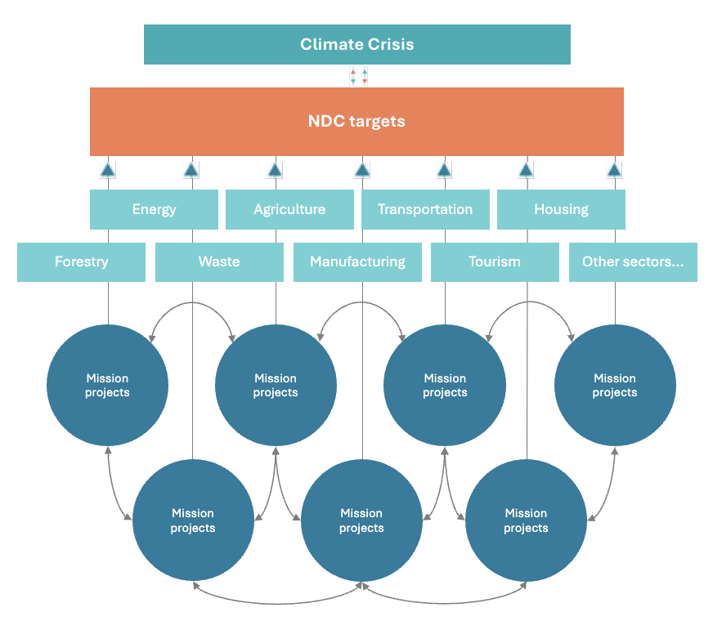
Recommendation 1
All G20 states should adopt ambitious green industrial strategies to drive sustainable, inclusive economic growth oriented around NDCs (instead of picking key sectors), to catalyze cross-sectoral investment, innovation and transformation.
7
Source: Mazzucato, M. (2018).
7

Slide 8
Recommendation 2
G20 countries should shift towards a whole-of-government approach in their response to the climate crisis.
Green industrial strategy should be enabled through changes to policy tools (like procurement) and public institutions (like SOEs) as well as a reorientation of fossil fuel subsidies. How this is implemented matters – interministerial, cross-sectoral, with deep civil society engagement.
Recommendation 3
Green industrial strategy
Health
Economy
Environment
Industry/ Innovation
Finance
Ministries
8

Slide 9
Recommendation 4
Governments and businesses should work in partnership to tackle climate change and deliver public value. Conditions can be embedded in subsidies, grants and loans provided to the private sector to turn them into levers for a just, sustainable transition.
Industrial Strategy with conditionality
Ensure that citizens and businesses have ACCESS to green goods, services and technologies.
DIRECT investments towards climate objectives.
Include PROFIT-SHARING provisions between contributing parties.
Promote the REINVESTMENT of business profits into productive activities.
Source: Mazzucato, M. and Rodrik, D. (2023).
9

Slide 10
Green industrial strategy cannot only be a national project
Recommendation 5
Recommendation 6
The G20 should explore the development of new global governance structures that enable national-level green industrial strategies while emphasizing global equity, shared ownership, and collaboration around shared climate goals.
Commitments to equitable green technology and knowledge transfer and to building distributed manufacturing capacity should be scaled up to ensure that all G20 countries are able to advance along new pathways for development that bring urgent climate action together with economic growth goals.
10

Slide 11
There is enough money, it just isn’t going to the right places
$1.11 trillion
In stock buybacks in 2023
Source: Janus Henderson & Factset, April 2023
$104 billion
Distributed in stock buybacks and dividends in 2023 by BP, Shell, Chevron, ExxonMobil, and TotalEnergies
Source: Ambrose, 2024
$7 trillion
On fossil fuel subsidies in 2022, including direct and indirect costs
Source: IMF, 2023
$500-600 billion
In corporate tax revenue lost per year due to tax havens
Source: Shaxson, 2019
$4.3 trillion
SDG financing gap for developing countries
Source: UNCTAD World Investment Report, 2022
1%
Of global financial assets need to be shifted to fill the SDG financing gap
Source: OECD, 2022
11

Slide 12
There is enough money, it just isn’t going to the right places
$2.2 trillion
Multilateral development banks (MDBs) total assets under management
$20.2 trillion
National development banks (NDBs) total assets under management
12

Slide 13
3. Financing the green transition

Slide 14
Recommendation 7
G20 countries—especially high-income G20 countries—should show leadership by providing and scaling up the financing required for economies to transform.
14

Slide 15
Recommendation 8
The G20 should reinforce existing calls for an equitable global financial architecture that supports countries’ ability to create fiscal space and raise capital for green investment. This includes:
Access to cheaper long-term capital
Improvements in domestic resource mobilization, carbon taxes and other international levies
Issuance and on-lending of SDRs
Adequate funding of MDBs and the IMF
Improvements in the debt management and resolution system
15

Slide 16
Recommendation 9
The G20 should emphasize the role of public development banks, including national, regional and multilateral development banks (NDBs, RDBs, MDBs) and empower NDBs to deliver patient long-term, NDC-oriented lending.
Recommendation 10
The G20 should align the financing strategies of NDBs, RDBs, and MDBs to respond to global and regional climate challenges.
16

Slide 17
Recommendation 11
The G20 Sustainable Finance Working Group, NGFS and G20 Global Partnership for Financial Inclusion should work together to develop strategies for enhancing inclusive green finance.
17

Slide 18
Recommendation 12
Central banks, supervisory and regulatory bodies should—within their mandates—implement policies that mitigate climate-related financial risks and foster the conditions for mobilizing private sector finance towards green investments and away from carbon-intensive ones.
Appropriate tools will vary by country and mandate, but could include:
Advancing more robust, globally standardized interoperable taxonomies and disclosure requirements
Reforming risk assessment processes by addressing data gaps
Adopting adequate forward looking climate risk models
Taking proactive measures to phase out carbon-intensive financing in collateral frameworks or corporate bond portfolios
Green credit allocation
18

Slide 19
Questions?

